Slide 1
BUSINESS INTELLIGENCE
(COURSE OUTLINE)
Prof. Dr. Ercan Oztemel

Slide 2
CONTENT-LEARNING OUTCOME
The content is to provide the course outline. It is expected to;
introduce basic business intelligence terminology
provide you with a managerial overview of data driven decision making
reveal opportunities in improving business performances with business analytics
introduce real-world business intelligence example
expose you to trends in business intelligence
practice your management skills in business intelligence project

Slide 3
Main Issue in Business: Data and knowledge
“We have mountains of data in this company, but we can’t access it.”
“We need to slice and dice the data every which way.”
“You’ve got to make it easy for business people to get at the data directly.”
“Just show me what is important.”
“It drives me crazy to have two people present the same business metrics at a meeting, but with different numbers.”
“We want people to use information to support more fact-based decision making.”

Slide 4
So what?
Capability to;
dig out the data
Analyse them
Create meaningful information
Report it to decision makers
BUSINESS
INTELLIGENCE

Slide 5
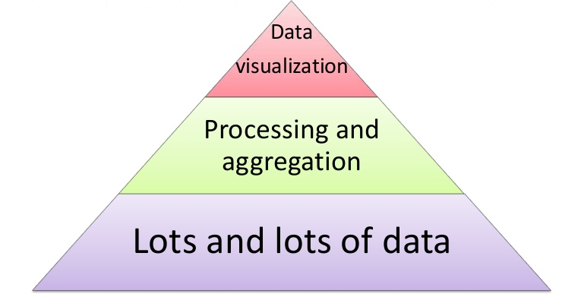
What is BI?
Business intelligence (BI) is a set of theories, methodologies, architectures, and technologies that transform raw data into meaningful and useful information for business purposes.
in other words;
BI is to extract the information deemed central to the business, and to present or manipulate that data into information that is useful for managerial decision support

Slide 6
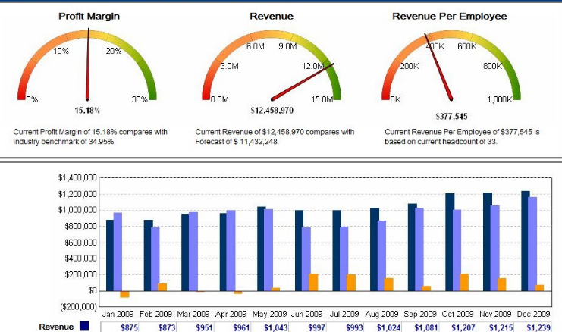
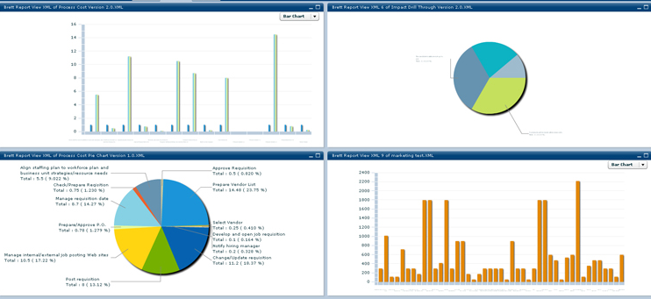
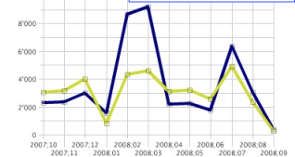
Business Intelligence
Reports
Data repository
Different systems

Slide 7
Information Delivery
Analysis
Reporting
Interactive visualization
Dashboards
Microsoft Office integration
Search-based data discovery
Ad hoc report/query
Geospatial and location intelligence
Mobile BI
Online analytical processing (OLAP)
Embedded advanced analytics
BI and analytics
(Gartner, 2014)
Integration
BI infrastructure and administration
Collaboration
Metadata management
Business user data mashup and modeling
Embeddable analytics
Development tools
Support for big data sources

Slide 8
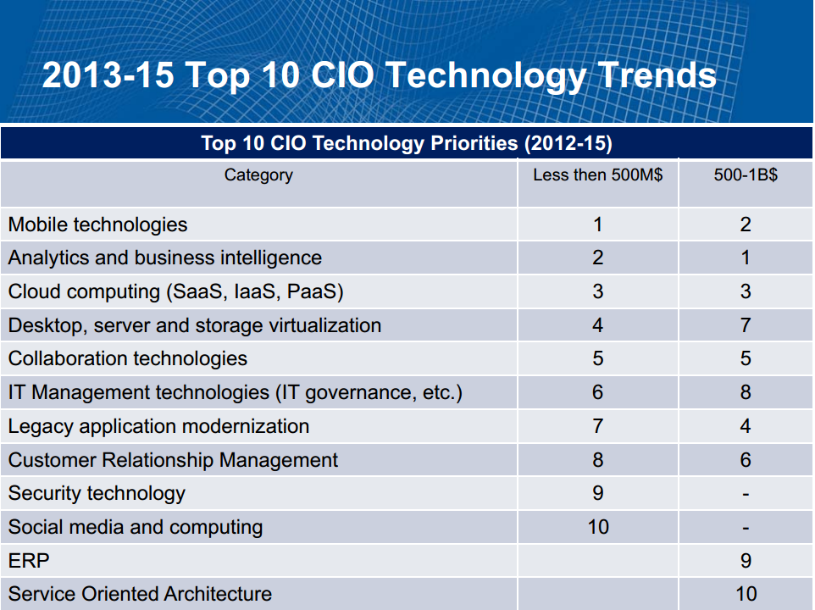

Slide 9
Course Topics
Week 1 | Course outline
Week 2 | General overview and introduction to BI
Week 3 | Decision making and knowledge management
Week 5 | BI tools and architectures
Week 6 | Bid data and data modelling
Week 7 | Data warehousing
Week 8 | Midterm
Week 9 | Data mining-1
Week 10 | Data mining-2
Week 11 | An example tool-1
Week 12 | An example tool-2
Week 13 | An example tool-3
Week 14 | Future trends

Slide 10
Projects
Each Student is going to prepare a Project.
The topics will be provided in the 4th week.
Each Project will contribute %50 to midterm grade.

